Slide 1
WORLD OF LASERS
Laser Application: Display

Slide 2
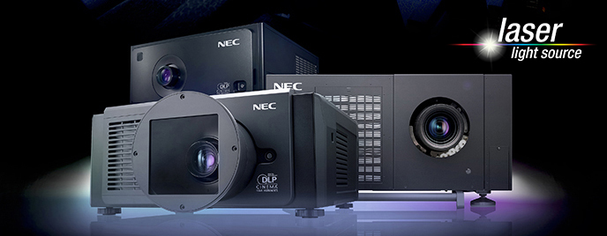
DISPLAY
Laser projection displays containing RGB sources can be used for cinemas, home videos, flight simulators etc.

Slide 3
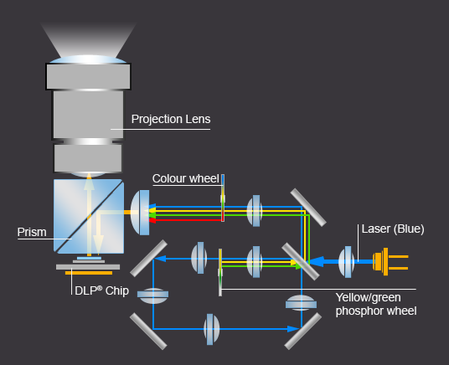
Laser Projection

Slide 4
LASER PROJECTION DISPLAYS
They are often superior to other displays concerning possible screen dimensions, resolution and color saturation.
HOWEVER . . .

Slide 5
LASER PROJECTION DISPLAYS
... further reductions in manufacturing costs will be essential for deep market penetration.

Slide 6
?
WELL DONE!
Move on to the next laser application...
SCIENTIFIC AREA!

